Slide 1
Sampling Techniques to Accelerate Pattern Matching in Network Intrusion Detection Systems
Author: Domenico Ficara, Gianni Antichi, Andrea Di Pietro,
Stefano Giordano, Gregorio Procissi, Fabio Vitucci
Publisher: IEEE ICC 2010
Presenter: Ching-Hsuan Shih
Date: 2014/07/16
Department of Computer Science and Information Engineering
National Cheng Kung University, Taiwan R.O.C.
Notes:
1

Slide 2
Outline
Introduction
Related Works
Sampling DFAs
Regex Sampling Rules
Double Stage Scheme
Experimental Results
Notes:
2

Slide 3
Introduction
Signature-based deep packet inspection has taken root as a dominant security mechanism in networking devices and computer systems.
Regular expressions are more expressive than simple patterns of strings and therefore able to describe a wider variety of payload signatures.
Our approach to the finite automato speed up is that sampling the text, thus having less symbols to process.
  Causing false positive.
Notes:
是一種裝置或者是軟體，用處是偵測網路中是否存在惡意的入侵式的動作。
大部分的IDS會解讀網路封包，系統日誌或者是網路流量來觀察是否有惡意的攻擊。
Pattern Matching是IDS中很重要部分，他用來找出packet中payload是否用包含惡意的動作，而這些惡意的動作我們會事先定義為pattern set

Slide 4
Related Works
Observing only 2 bytes per cycle would require each DFA state to include 2¹⁶ transitions. To solve this problem, the authors of [7] suggest a solution by observing that in actual FAs the number of different transitions is more limited.
The authors of [6] try to make a k-DFA feasible by taking advantage of alphabet-reduction.
Notes:
特色是它可以同時match pattern set中的所有pattern
它可以支援較大型的pattern set
需要對pattern set做一些前處理來建立資料結構

Slide 5
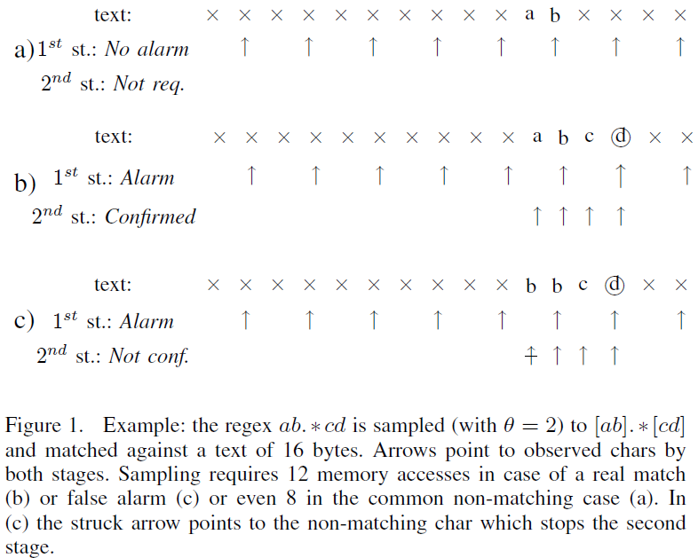
Sampling DFAs
A Motivating Example
Notes:
特色是它可以同時match pattern set中的所有pattern
它可以支援較大型的pattern set
需要對pattern set做一些前處理來建立資料結構

Slide 6

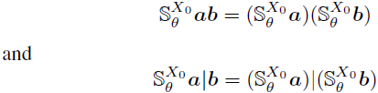

Regex Sampling Rules
Regex Rewriting
  Sampling a string is straightforward, it consists of extracting characters at the positions defined by θ with offset X₀:
  The offset X₀ is critical also when sampling the concatenation and union of regular expressions, it is immediate to show that:
  Example:
Notes:
特色是它可以同時match pattern set中的所有pattern
它可以支援較大型的pattern set
需要對pattern set做一些前處理來建立資料結構

Slide 7

Double Stage Scheme
First stage: Sampled DFA
  Some regexes may be so short to make sampling inconvenient. For instance
  : it is only 1-character long, thus potentially yielding a large number of false alarms.
  A solution is to hardcode them.
Second stage: Reverse DFA
  If a matching happens in the “sampled DFA”, we have to process the text again to obtain a confirmation of the match.
  All the regexes have to be independently reversed and a new DFA has to be built according to such new rules.
  Ex. (abcde*)^{R} = e*dcba
Notes:
特色是它可以同時match pattern set中的所有pattern
它可以支援較大型的pattern set
需要對pattern set做一些前處理來建立資料結構

Slide 8
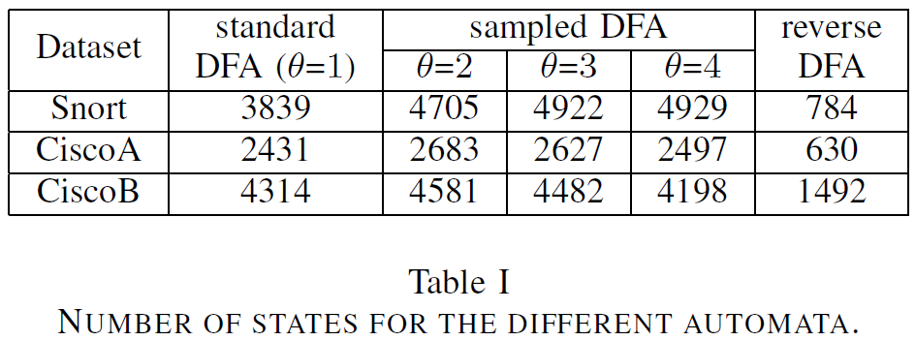
Experimental Results (1/2)
Notes:
特色是它可以同時match pattern set中的所有pattern
它可以支援較大型的pattern set
需要對pattern set做一些前處理來建立資料結構

Slide 9
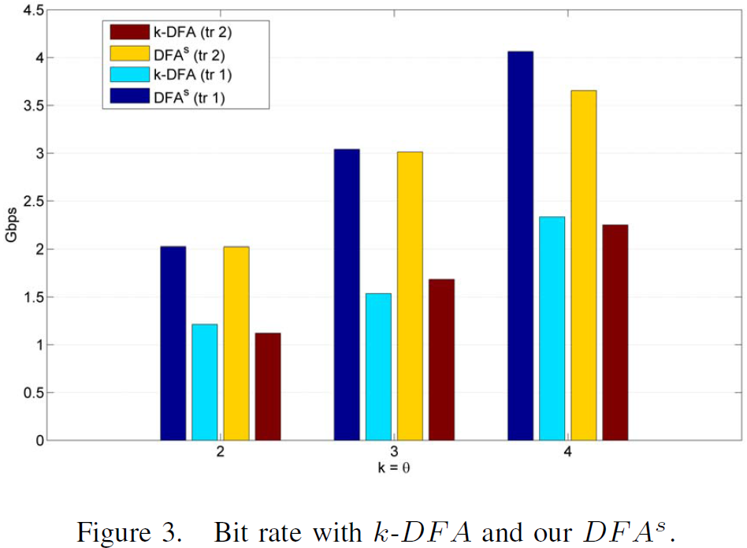
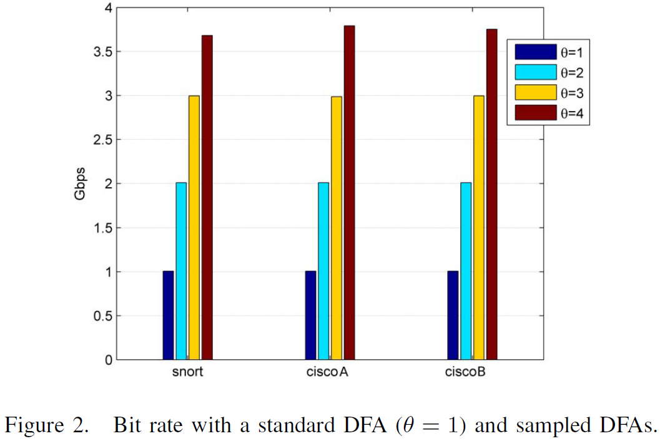
Experimental Results (2/2)
Notes:
特色是它可以同時match pattern set中的所有pattern
它可以支援較大型的pattern set
需要對pattern set做一些前處理來建立資料結構

